Slide 1
Location Models
Hadir A. Garcia Castro
André Bergsten Mendes
Departamento de Engenharia Naval e Oceânica
Universidade de São Paulo
2019

Slide 2
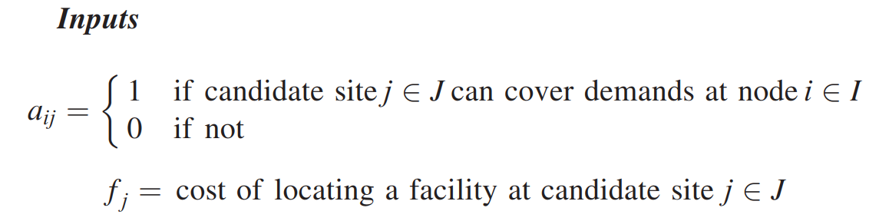
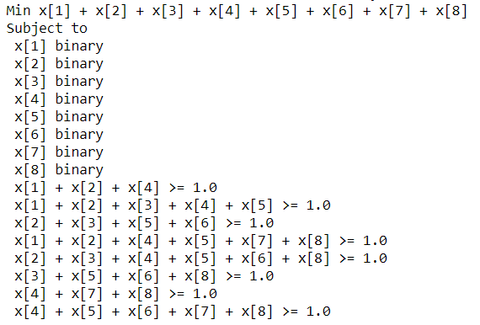
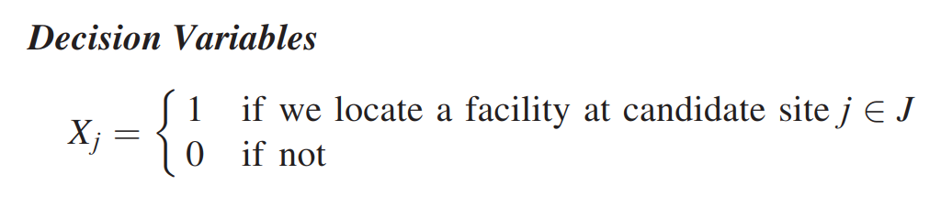
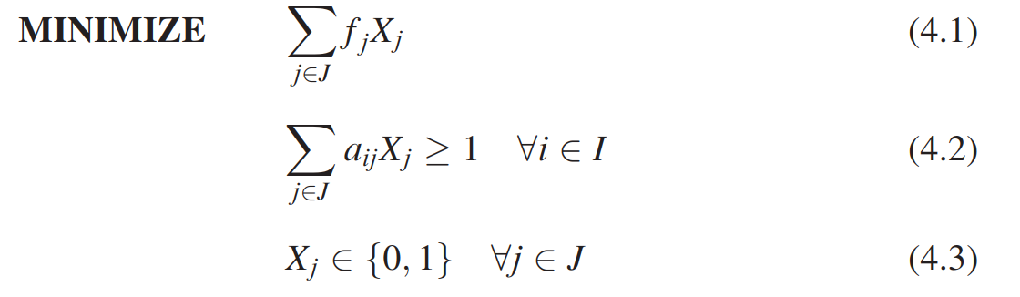
Set Covering Location Models
LP Model

Slide 3

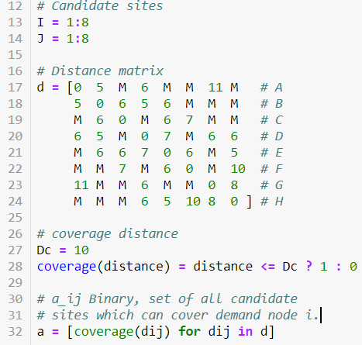
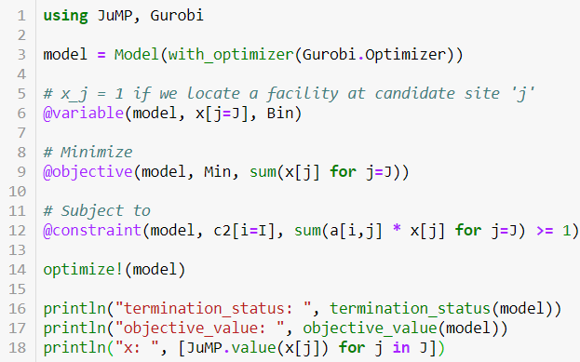
Set Covering Location Models
Inputs
Model

Slide 4
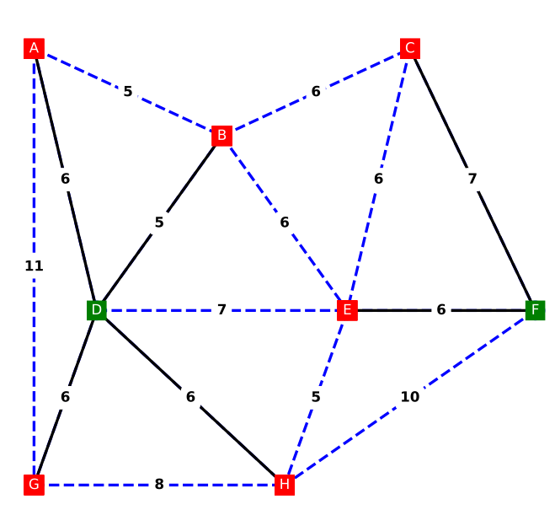

Set Covering Location Models
Solution

Slide 5
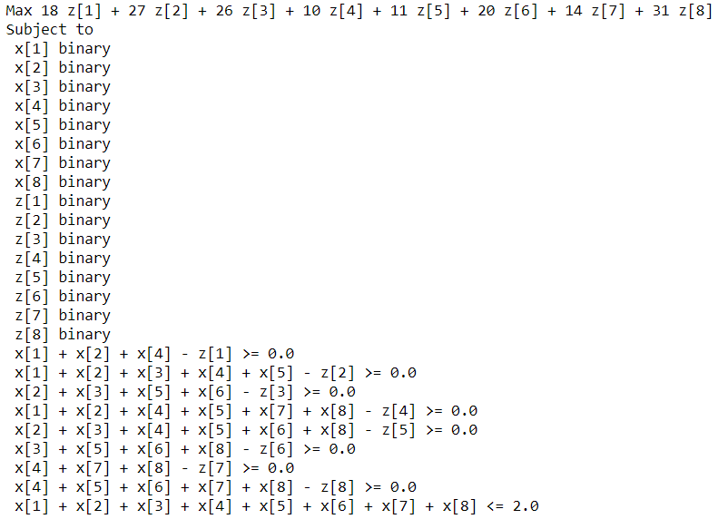

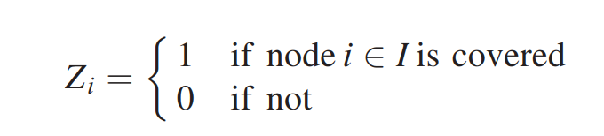
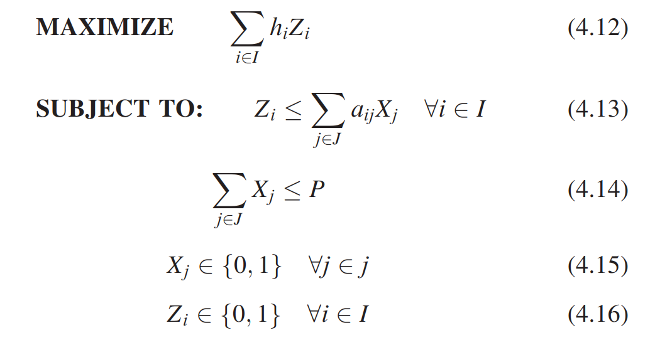
Maximum Covering Location Models
LP Model

Slide 6
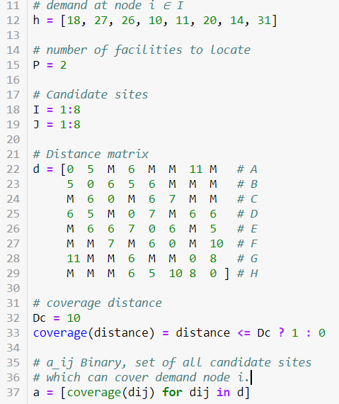
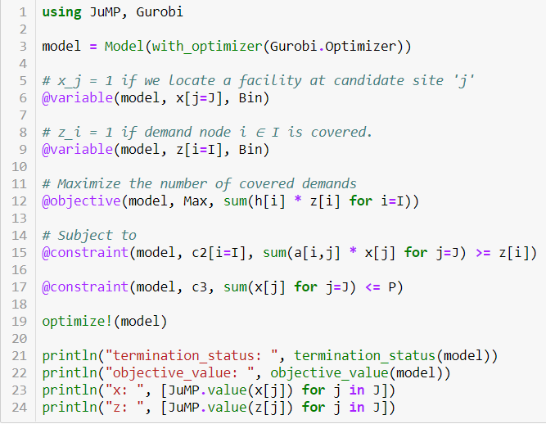
Set Covering Location Models
Inputs
Model

Slide 7
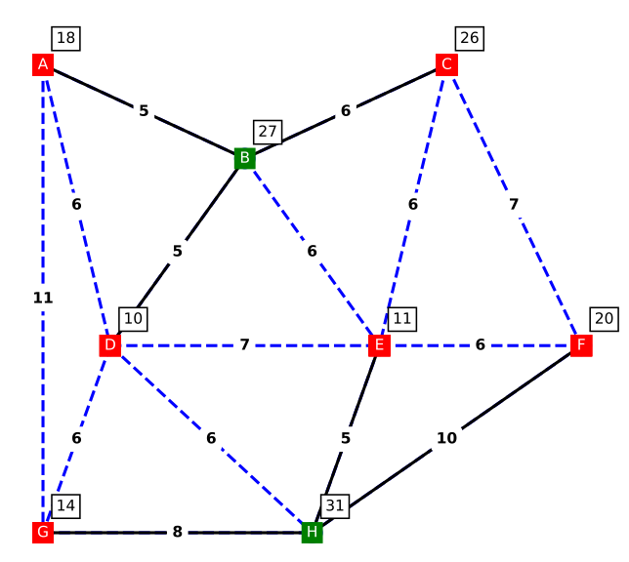

Set Covering Location Models
Solution

